Slide 1
Tableau AND SQL PROJECT : Bike-Share Dashboard
By Amirul Afiq Rosli

Slide 2
Introduction
The Process flows
This is the project that I have done by using SQL for cleaning the dataset, and convert cleaned data to txt file to be by importing the Tableau to make business intelligence dashboard for visualization purpose.
Identify Objectives
Find Dataset
Cleaning Dataset
Upload Excel File and the Cleaned Dataset into PowerBI
Upload Into Github
Making Interactive Dashboard

Slide 3
Identify Objectives
Objectives :
Identify the most ride per month.
Identify the most rideable type preferred by customers
Identify the most ride length by weekday and rideable type
What to do?
1. Making data cleaning in SQL.
2. Making a Bike-Share Dashboard.

Slide 4
Find Dataset
Sources: 2021-divvy-tripdata.zip lists
Dataset name : Dataset Link : https://divvy-tripdata.s3.amazonaws.com/index.html

Slide 5
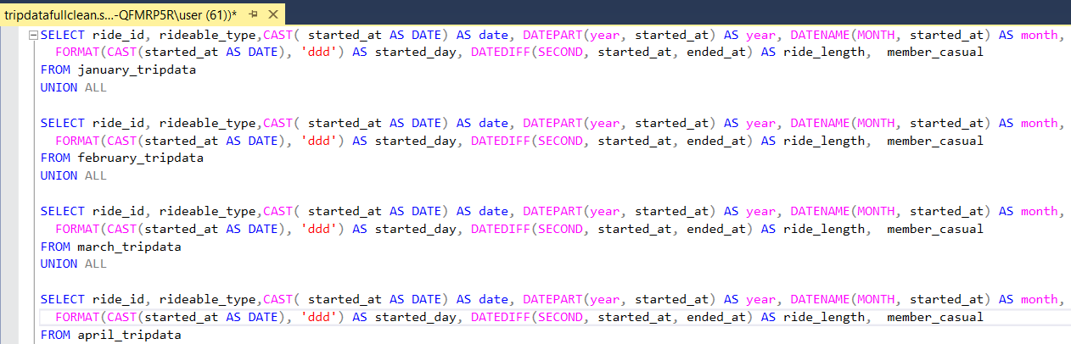
Cleaning Dataset
Tools :
SQL Server Management Studio Management Studio 19
Process:
Cleaning the dataset by making union all clauses to combine data from January 2021 to December 2021.
2. The purpose is to extract the dataset to meaningful information.
The queries done :

Slide 6
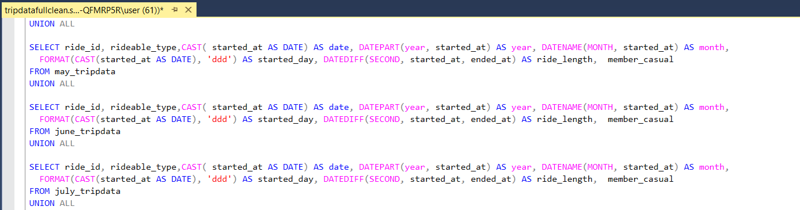

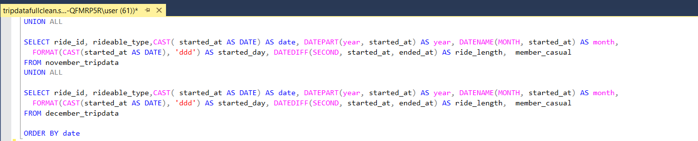

Slide 7
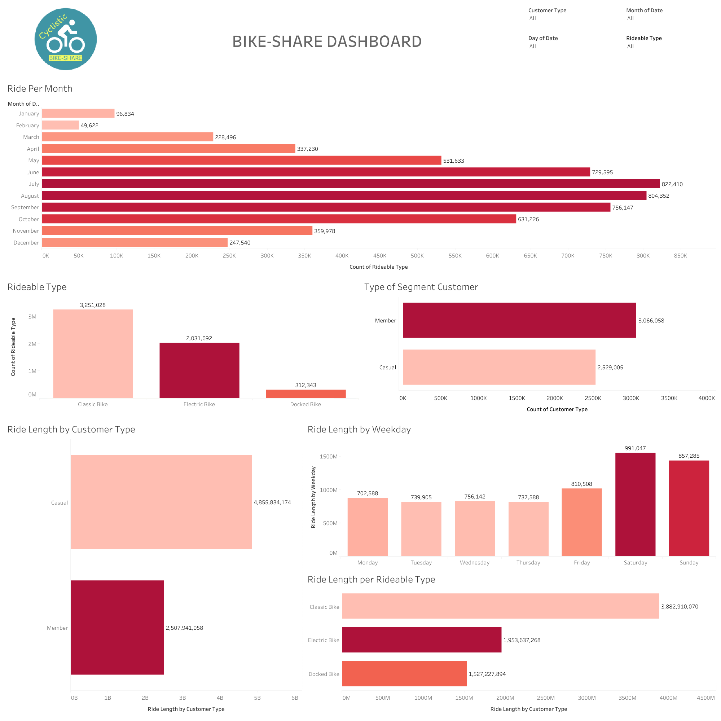
Making Interactive Dashboard

Slide 8
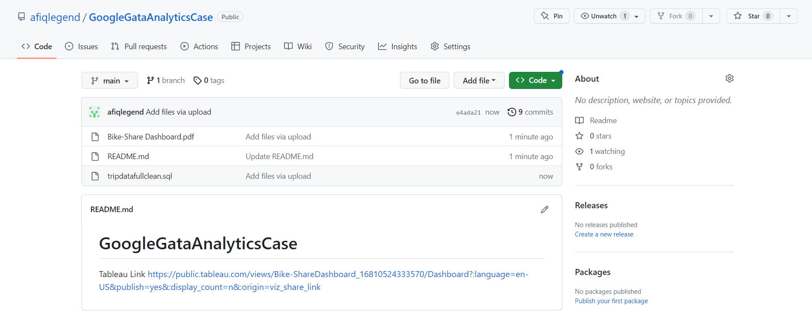
Upload Into Github
Upload all my project files into Github for completing the portfolio.
Link : https://github.com/afiqlegend/GoogleGataAnalyticsCase

Slide 9
Conclusions
The results:
The most ride per month is on July which is 822,410.
The most rideable type preferred by customers is Classic Bike which is 3,251,028.
The most ride length by weekday is on Saturday which is 991,047 and the most ride length by rideable type Classic Bike which is 3,882,910,070 second.
What I have learnt:
How to make the queries in SSMS to clean the dataset to be the useful information for visualization purpose.
How to make interactive dashboard in Tableau to summarize a lot of figure and text to the visual report to absorb the data easier.
Learn a little of business logics.

